Slide 1
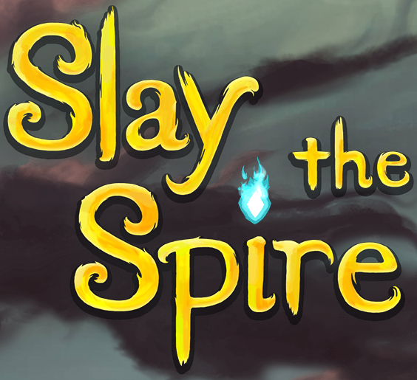
Analysis of an act in Slay the Spire
By Austin Jacobs

Slide 2
About This Level
Slay the Spire is a roguelike deckbuilding game
Each run, the player starts with a prebuilt deck
Random events and winning battles gives the player options to add, remove, or modify cards in their deck
Combat is turn based
Each turn, the player can play any number of cards whose total cost add up to the player’s mana
This analysis is of the first of four Acts

Slide 3
Concept
The player is tasked with reaching the top floor of the act
Along the way are enemies, random events, shops, and rest stops

Slide 4
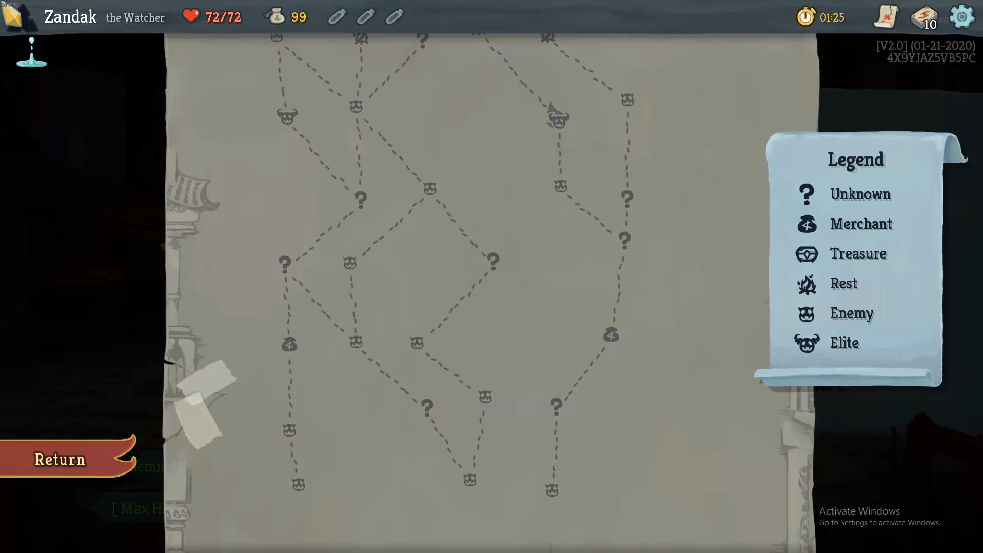

Slide 5
Environment
Slay the Spire takes place in large dangerous tower
The goal of the player is to reach the top of the tower and slay the Heart
The background of each room is a static image that changes the higher the player gets

Slide 6
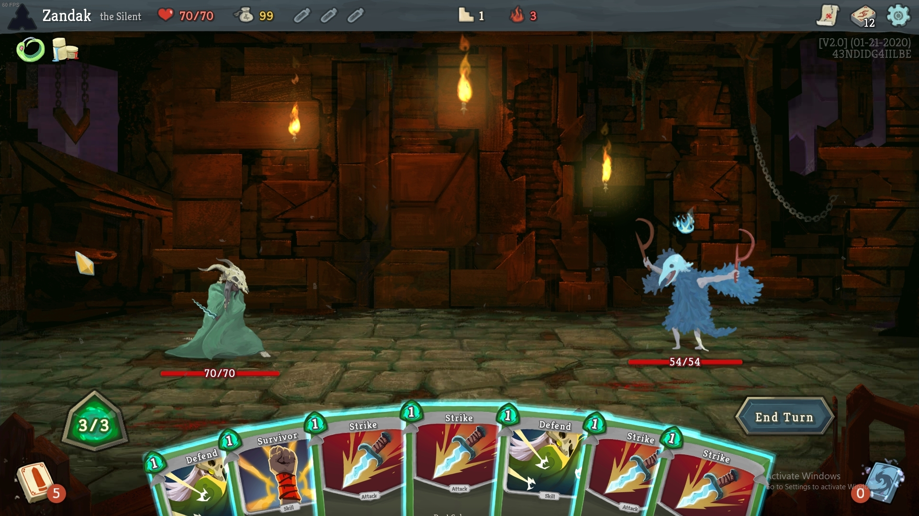

Slide 7
Beginning
At the beginning of a run, the player is met by Neow, a big whale-like creature
Neow offers the player a bonus
The bonus improves based on the player’s performance in the previous run

Slide 8
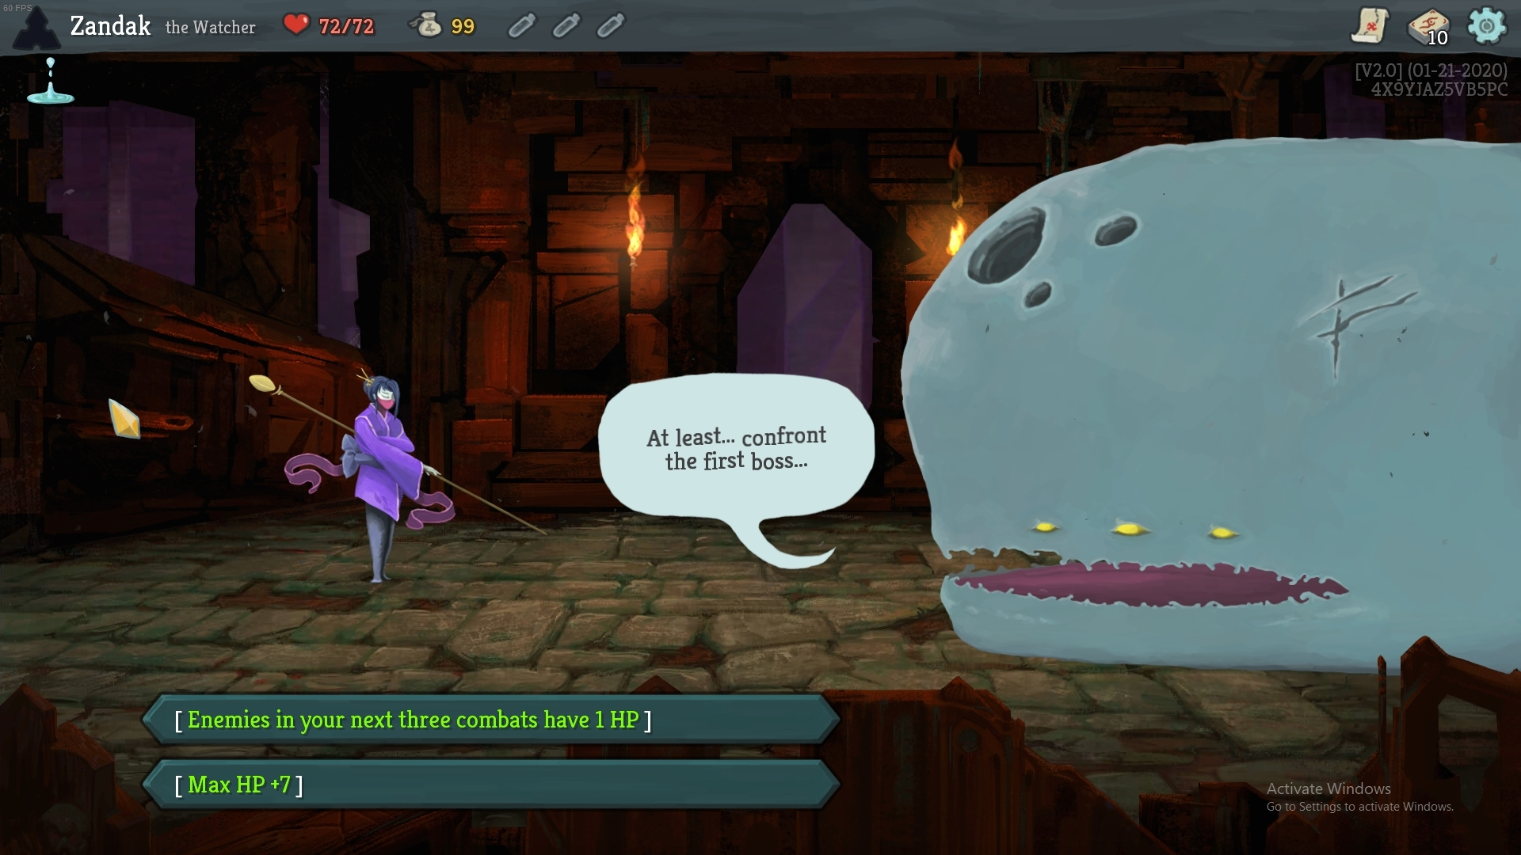

Slide 9
Ending
The last room in the act is a boss
In Act I, there are 3 bosses
Which boss you face is randomly chosen

Slide 10
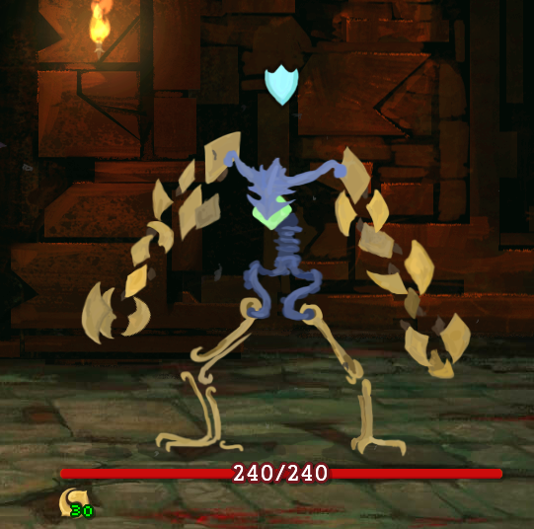

Slide 11
Goal
The goal is to defeat the boss
If the player reached 0 HP they lose, and the run is over

Slide 12
Challenge to Overcome
Each room along the path to reach the boss contains a challenge or a reward
These include:
Enemies
Traps
Curses
Shops
Chests
Rest areas

Slide 13
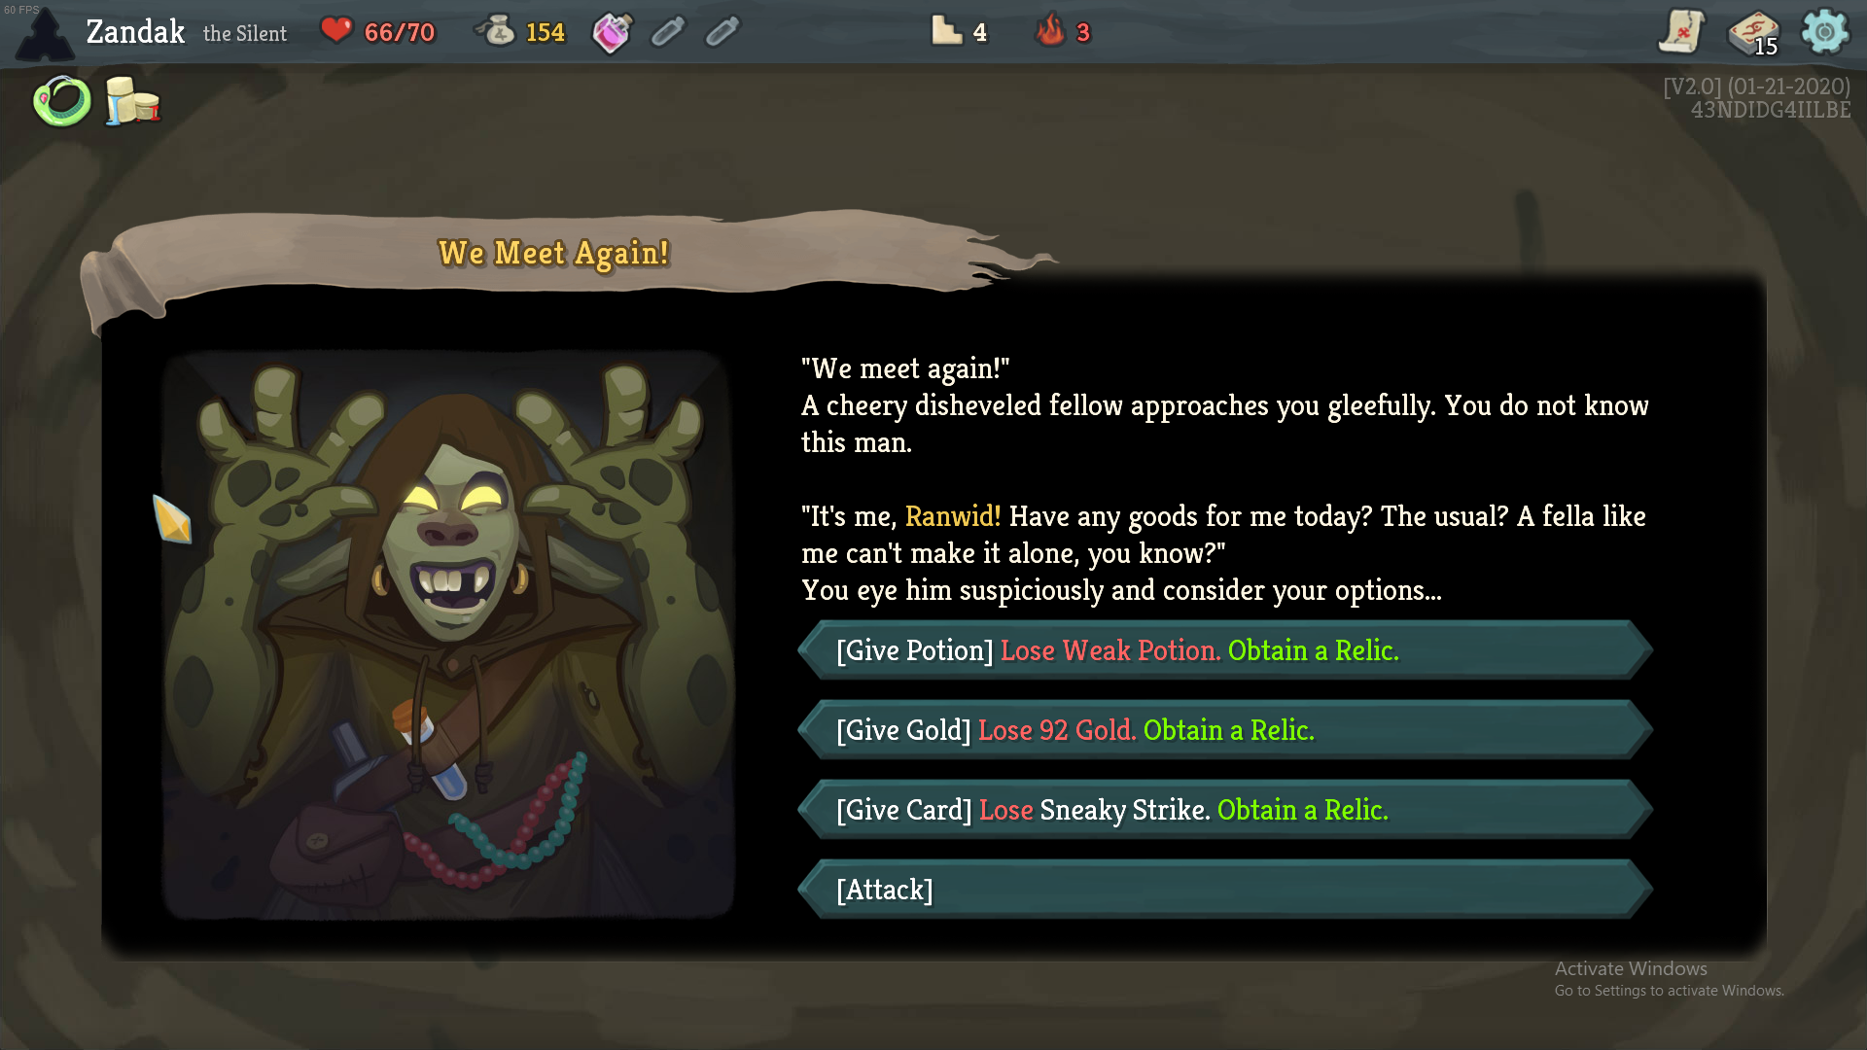

Slide 14
Reward
After each combat, the player is rewarded with gold and a card to add to their deck
Some rooms have chests which contain powerful relics
Some rooms can have random events where a reward is given
Others contain random events where the player receives a reward at a price
The reward for defeating the boss at the end of the Act is a full restoration of their HP, gold, a rare card, and a choice from 3 powerful relics

Slide 15
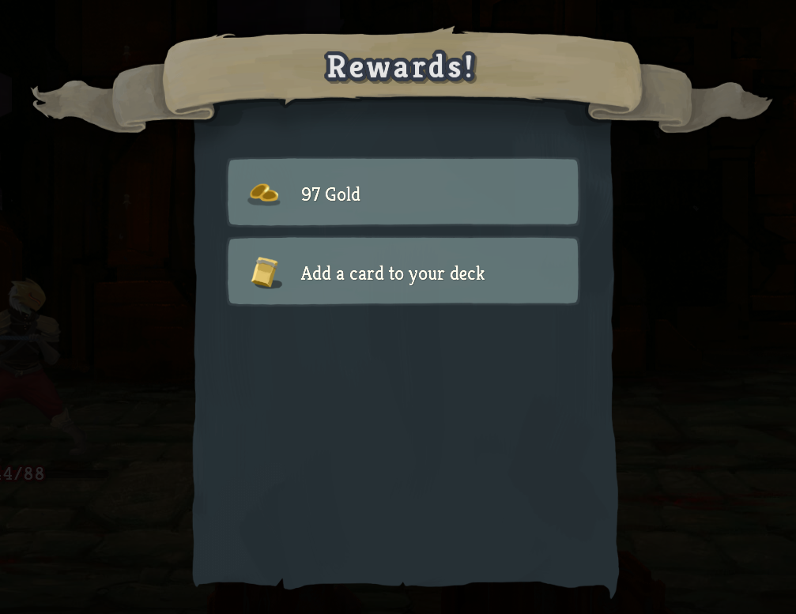

Slide 16
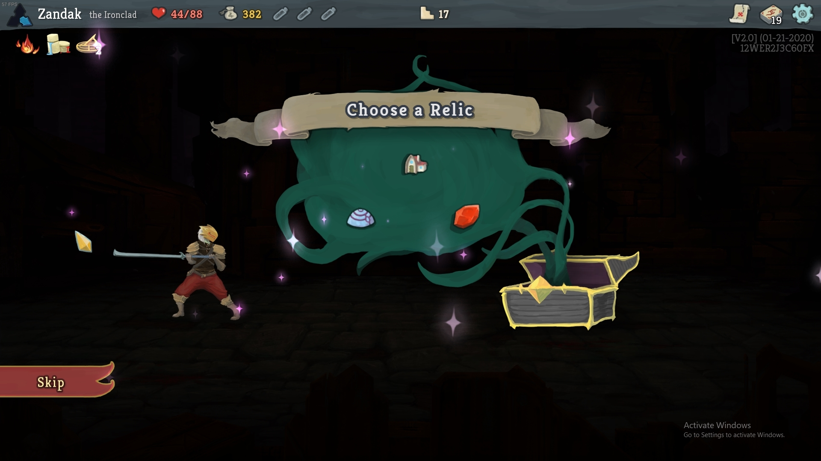

Slide 17
Failure
If the player reaches 0 HP, they lose
In essentially all combats, the only way for the player to progress is to win
The player is in the combat until either they, or the enemy, reach 0 HP
Some random events will give the player a choice between three unfavorable punishments

